Slide 1
SAM Project Kick-Off
Trevor Holmes

Slide 2



Introduction
Workshop Welcome & Objectives
Stakeholders and Outcomes

Slide 3






Workshop Welcome and Objectives
Welcome to the SAM Project Kick-Off Workshop.
Today we are going to reconfirm the outcomes we want from this SAM enablement project, identify the systems and people resources we need, and agree on an initial timeline for delivery
Understand and confirm the overall solution requirements for the project
Establish the FNMS high level solution architecture
Identify dependencies between FNMS and other systems and processes in the organization
Agree on project governance and progress reporting practices to be adopted for the duration of the project

Slide 4

about this slide deck …
The slides here are arranged to walk us through the discussions we need to have at the outset of this project
Where we have pre-provided “answers” to key questions, we will use these slides to reconfirm, or as necessary update those starting positions
Some of the slides here will be more central to discussions in the Design and Project Management Workshops

Slide 5

Stakeholders
Introduction
Let's go round the room and get everyone to introduce themselves, and hear what their keys goals are, and what SAM outcomes they want to achieve in this project …
GOVERNANCE
SQUAD
< CUSTOMER >
< CUSTOMER >
Crayon
Sponsor: tba
Project Manager: tba
BAU Lead: tba
SAM Manager: tba
SAM Practitioner: tba
Project Manager: tba
IT Architect: tba
Infrastructure Lead: tba
IT Lead: tba
Project Lead: tba
Tech Consultant: tba
SAM Consultant: tba
Scrum Master: tba
Crayon
Sponsor: David Jensen
Account Manager: tba

Slide 6


Implementation Scope
Starter – SAM Data Model
Asset Number ?
Data System Connections ?
Software Vendors ?

Slide 7
To start, lets look at the SAM Data Model
Purchase data sources
Flexera Content Libraries
Vendor data sources
Purchase
Application
Vendor
License
Contract
#Entitlements
User
HR data sources
Contract data sources
SaaS Usage
Inventory
Device
# Consumed
Organizational data sources
Enterprise
Group
SaaS data sources
Asset
Asset data sources
Inventory data sources

Slide 8

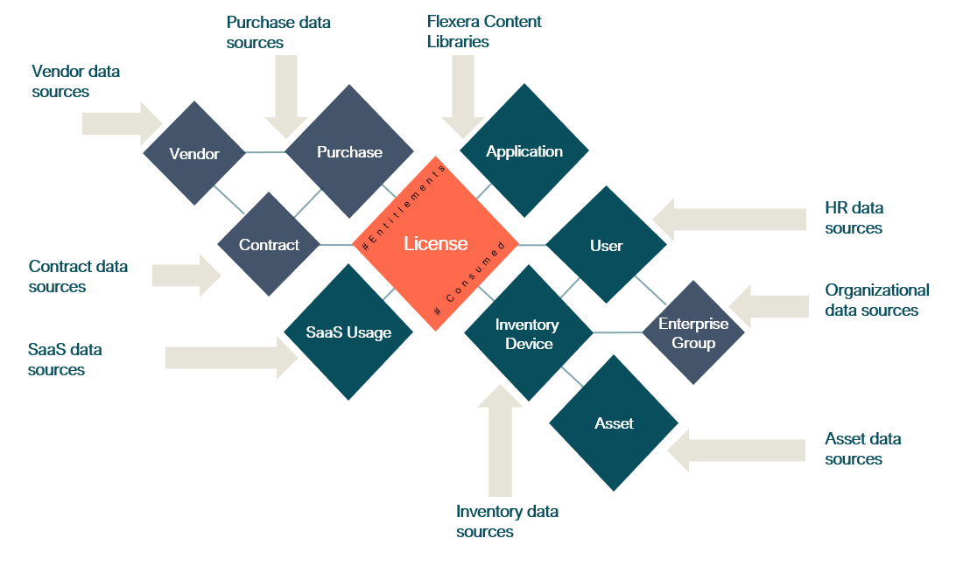
SAM Services Architecture
CMDB & Service Mgmt Systems
SAM Users
HR & Procurement Systems
SAM Systems
SAM Managed Service Administrators
Software Request System
EUC Network & Systems
Software Deployment Systems
Data Centre Network & Systems
Cloud SaaS & IaaS Networks & Systems
EUC Users

Slide 9

Which are the key Software Vendors?
IMPLEMENTATION SCOPE
Vendor | Yearly Spend ($M) | Vendor | Yearly Spend ($M)
Microsoft
Oracle
IBM
VMWare
Adobe
Red Hat

Slide 10
What key technology stacks are we using?
IMPLEMENTATION SCOPE
Inventory Type | Data Sources
Device inventory | e.g. SCCM
Application Virtualisation | e.g. Citrix XenApp, VMWare App Volumes
Desktop Virtualisation | e.g. Citrix XenDesktop, VMWare Horizon
Cloud Server Infrastructure | e.g. Microsoft Azure, AWS
On-prem Server Infrastructure | e.g. VMWare, Hyper-V
Containerization | e.g. Docker, Kubernetes, Rancher, AWS, etc.
Cloud Software Services | e.g. Microsoft 365

Slide 11
What are the key systems manage business data?
IMPLEMENTATION SCOPE
Business Record Type | Data Sources
Assets | e.g. ServiceNow
Purchases
Contracts
Users | e.g. PeopleSoft
Vendors
Enterprise Groups

Slide 12
What types of Inventory Devices are we managing?
IMPLEMENTATION SCOPE
Device Type | Estimated number
Desktops and laptops | ###
Virtual Desktops | ###
Servers – on-prem | ###
Servers – cloud hosted | ###

Slide 13
What operating systems are we managing?
IMPLEMENTATION SCOPE
Operating System | Estimated number
Windows | ###
Oracle Linux | ###
Redhat | ###
AIX | ###
Solaris | ###
Others | ###

Slide 14
What other integrations are needed?
IMPLEMENTATION SCOPE
Integration Type | System to integrate with
Software Requests | e.g. ServiceNow, App Portal, Jira
Configuration Management | e.g. ServiceNow
Budgeting and forecasting tools | e.g. Aptio
Others?

Slide 15


Solution Architecture
Starter – SAM Data Model
Asset Number ?
Data System Connections ?
Software Vendors ?

Slide 16



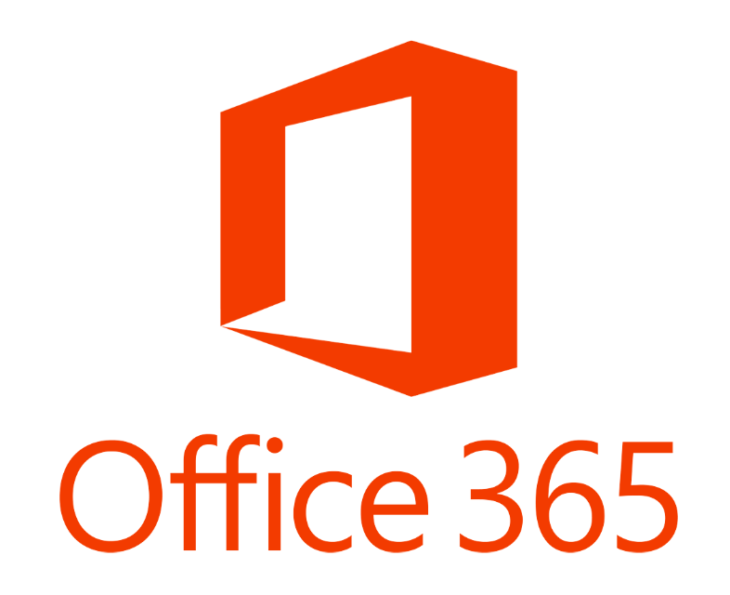




IMPLEMENTATION SCOPE
What systems and services are needed in Production ?
Cloud
VMware
Out of the box connectors
Azure
PRODUCTION
AWS
FNMS App Server
FNMS Beacon
svr0000001pr.acme.com
Oracle physical
servers
Site-2
Site-1
FNMS Beacon
svr0000004pr.acme.com
VMware
FNMS Beacon
svr0000005pr.acme.com
nbnTM
FNMS Cognos
svr0000003pr.acme.com
FNMS DB Server
VMware
svr0000002pr.acme.com
ETA Sep 30

Slide 17
Key Design Parameters
SOLUTION ARCHICTURE
Parameter | Value
FNMS architecture | Cloud/on-prem
Locations of devices | Intranet/Internet? Data Centers? Regions?
# operators using the system
Environments? | Production UAT / Non-Prod / Test? Other?
Integrations | Software requests (e.g. App Portal)?

Slide 18
Logical Architecture
SOLUTION ARCHICTURE
Edit and add additional other types of external systems
if applicable (e.g. App Portal)

Slide 19
Device Numbers
SOLUTION ARCHICTURE
Item | Value
Device Operating Systems
Include Desktops
Include Servers

Slide 20
Environments
SOLUTION ARCHICTURE
Environment Name | Purpose
Production
User Acceptance Testing
Other?

Slide 21
Inventory Data Sources (1)
SOLUTION ARCHICTURE
Environment / Technology / Application | Required? | Technology/ies used to gather inventory | Notes
General hardware & software inventory on end-user computers running Microsoft Windows |  | FNMS Agent, Others?
General hardware & software inventory on servers & computers running Microsoft Windows |  | FNMS Agent, Others?
General hardware & software inventory on servers running UNIX-like operating systems |  | FNMS Agent, Others?
General hardware & software inventory on servers running OS X |  | FNMS Agent, Others?
Citrix XenApp |  | FNMS XenApp server agent
Citrix XenDesktop |  | FNMS Xen Desktop discovery & inventory functionality
Microsoft Application Virtualization (App-V) |  | FNMS adapter for Microsoft App-V
Microsoft Office 365 |  | FNMS adapter for Microsoft Office 365
Microsoft Client Access Licenses (CALs) |  | FlexNet inventory agent

Slide 22
Inventory Data Sources (2)
SOLUTION ARCHICTURE
Environment / Technology / Application | Required? | Technology/ies used to gather inventory | Notes
Oracle Database |  | FlexNet inventory agent
VMware vSphere vCenter or ESX/ESXi |  | FNMS Vmware infrastructure discovery & inventory functionality
Microsoft Hyper-V |  | FlexNet inventory agent
Oracle VM Server for x86 |  | FNMS Oracle VM discovery & inventory functionality
Unix partitioning: LPARs, Zones, nPars/vPars |  | FlexNet inventory agent
Microsoft SQL Server |  | FlexNet inventory agent
Microsoft Exchange Server |  | FlexNet inventory agent
IBM WebSphere MQ Queue Manager state via dspmq |  | FlexNet inventory agent

Slide 23
Business Data Sources
SOLUTION ARCHICTURE
Data related to … | Source(s)
User (people) details
Hardware assets
Location hierarchy
Cost centre hierarchy
Business unit hierarchy
Purchases
Contracts
Vendors
Inventory Device Roles
Relationships between the above record types

Slide 24
Physical Architecture (cloud)
SOLUTION ARCHICTURE
Edit and add additional other types of external systems
if applicable (e.g. App Portal)

Slide 25
Physical Architecture (on-prem)
SOLUTION ARCHICTURE
Edit and add additional other types of external systems
if applicable (e.g. App Portal)

Slide 26
Inventory Beacon Placement
SOLUTION ARCHICTURE
Beacon Location | Beacon functions
 | e.g. Inventory Gathering – Intranet devices Inventory Gathering – Internet devices Business adapter connections Inventory connections

Slide 27
Security Architecture
SOLUTION ARCHICTURE
Account | Used for … | Rights needed
End user account | Logging on to FNMS
FNMS Service Account | Running services on the FNMS servers and Inventory Beacons
Agent Authentication Account | FNMS agent authenticating itself to Inventory Beacons
Office 365 Authentication token | Inventory Beacon authenticating itself to Azure to gather Office 365 data
XenApp Service Account | Run the FNMS XenApp Server Agent

Slide 28
Hardware Requirements
SOLUTION ARCHICTURE
Server | Requirements
FNMS Application Server | Standard Server Operating System Server Location How requirements may differ for each environment Hosted in domain
FNMS Database Server
FNMS Inventory Beacon

Slide 29
Disaster Recover Architecture
SOLUTION ARCHICTURE
Edit and add additional other types of external systems
if applicable (e.g. App Portal)

Slide 30
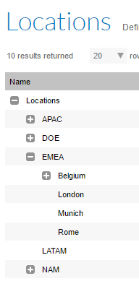
Enterprise Groups
SOLUTION ARCHICTURE
Hierarchy (tree) structure representing
Locations
Cost centers
Corporate (business) units
Useful for grouping and managing other records; for example:
Licenses may be scoped to only apply to individual locations
Access rights may be configured so a user can only see data for a particular corporate unit
Hardware assets may be assigned to cost centers to support chargeback analysis
Discuss: How might these structures be modelled for your organization?
Where is data for these models available?
What data associate's computers & users to groups?

Slide 31
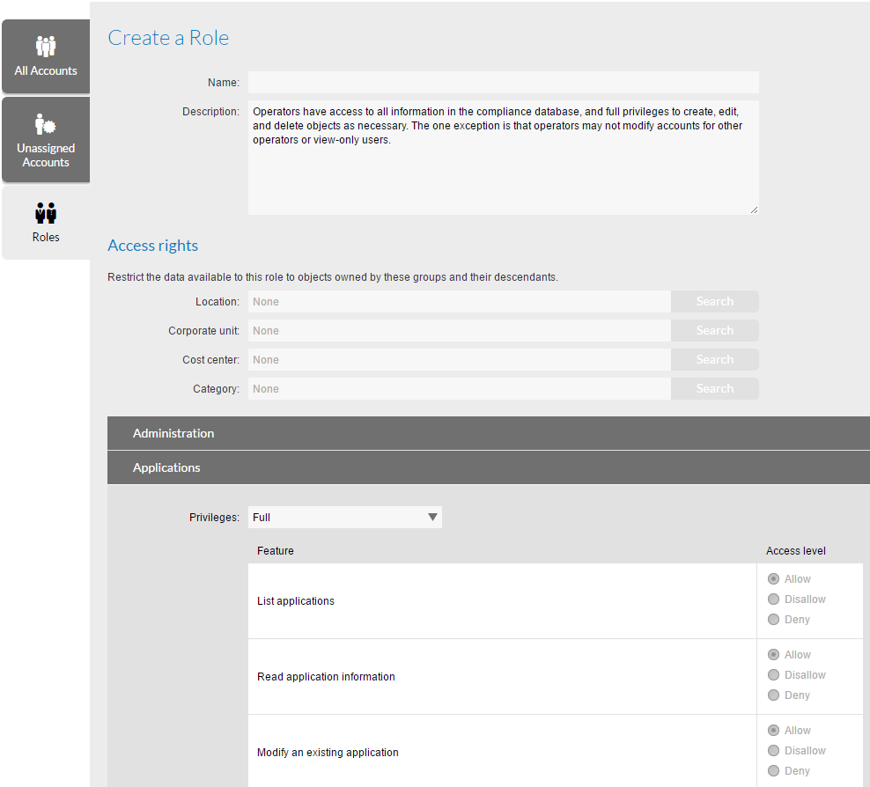
Access Control (Roles)
SOLUTION ARCHICTURE
Roles can be configured in FNMS to restrict rights for users of the system based on:
Operation performed
Enterprise group of data records to be accessed
Will different groups of users require different levels of access?
What responsibilities will different user groups have?

Slide 32
Access Control (Roles)
SOLUTION ARCHICTURE
Type of operator | Types of operations they will need to do in FNMS | Enterprise groups they will need access to data for

Slide 33
Data Model Extensions
SOLUTION ARCHICTURE
Many parts of the FNMS data model can be extended by:
Additional of custom properties
Customization of values available in drop down lists
Definition of custom types of hardware assets and contracts
For example:
Hardware asset records could be customized with additional properties such as “Due for refresh” or “Assigned project”
The hardware asset status drop down list could be customized with the addition of an “In storage” status

Slide 34

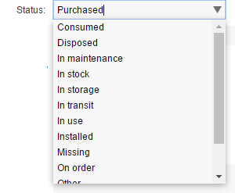
Data Model Extensions
SOLUTION ARCHICTURE
Objects that can be extended:
Controls available:
Asset
Computer
Purchase
Contract
License
User
Vendor
Application
Integer
Text box
Text area
Date
Check box
Drop-down list
NB. Each control can be read-only or read-write in the web UI

Slide 35
Reporting
SOLUTION ARCHICTURE
The FNMS system provides many reports and powerful configurable “custom views” out of the box
Discuss any specific known reporting needs that should be considered during design
For example, do particular people/roles need specific reports from the system to help them do their job?

Slide 36
Sep 21 - Sep 22
Sep 21 - Oct 2
Nov 2 - Nov 13
10/5 - 10/16
14 days
1 day
9 days
9 days
14 days
9 days
9 days
9 days
9 days
9 days
8 days
9 days
9 days
2020
Indicative Timeline
Executive Review
March 6, 2021
Inception
Project Kick-off
Beta Release
Release to BAU
August 3, 2020
September 21, 2020
December 21, 2020
March 26, 2021
Aug
Sep
Oct
Nov
Dec
2021
Feb
Mar
2021
Today
Kick-Off Workshop
S1: Planning & Design Workshops
Project Plan Approved
October 5, 2020
Planning and Design
9 days
S2: Implementation Design
Design Approved
October 18, 2020
S3: Alpha Build
S4: Non-Prod Build
Dec 14 - Jan 1
Non-Prod Acceptance
Oct 19 - Oct 30
S5: Non-Prod Test
Jan 4 - Jan 15
9 days
November 30, 2020
Nov 16 - Nov 27
Tools Implementation
S7: Production Build
Ready for Pilot
January 4, 2021
S8: Pilot
Production Acceptance
January 22, 2021
S1: Vendor Discovery Workshops
Sep 21 - Oct 2
Oct 5 - Oct 16
Nov 16 - Nov 27
S3: Second Vendor
Dec 14 - Jan 1
S2: First Vendor Entitlements
Nov 30 - Dec 11
S5: Fourth Vendor
Vendor Onboarding
Oct 19 - Oct 30
S4: Third Vendor
S6: Test Load
Nov 3 - Nov 14
S7: Production Load
First Reports
January 8, 2021

Slide 37

Sam Kick-Off

Slide 38

Q&A

Slide 39







